Slide 1
Teaching Survey Research in Software Engineering
Handbook on Teaching Empirical Software Engineering
Authors:
Marcos Kalinowski (Pontifical Catholic University of Rio de Janeiro)
Allysson Allex Araújo (Federal University of Cariri)
Daniel Mendez (Blekinge Institute of Technology, fortiss)

Slide 2
Agenda
1
Course Syllabus
2
Characteristics and Purpose of Survey Research (LO1)
3
Designing and Evaluating Survey Instruments (LO2)
4
Sampling and Data Collection (LO3)
5
Statistical and Qualitative Analysis (LO4)

Slide 3
Agenda
6
Threats to Validity and Reliability (LO5)
7
Ethical Considerations
8
Concluding Remarks

Slide 4
1) Course Syllabus
For further information, see section 2 in the chapter.

Slide 5
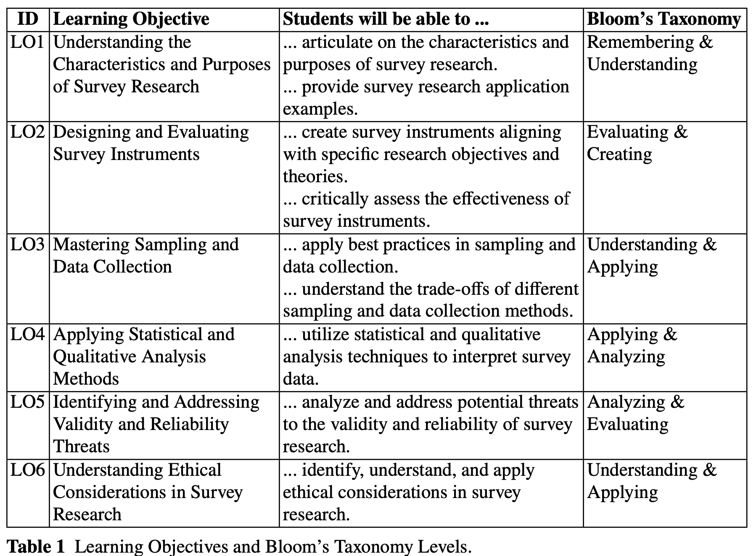
Course syllabus
The course provides a comprehensive overview of survey research principles and practices.
How to design and evaluate survey instruments, focusing on aligning them with research objectives and relevant theories.

Slide 6
2) Characteristics and Purpose of Survey Research (LO1)
For further information, see section 3.1 in the chapter.

Slide 7



Characteristics
Survey is an observational method to gather qualitative and/or quantitative data from (a sample of) entities to characterize information, attitudes and/or behaviors from different groups of subjects regarding an object of study.
Surveys
(Cross-sectional)
Case Studies
Experiments
(Case-control)

Slide 8
Characteristics
Surveys are probably the most commonly used research method worldwide.
Surveys are conducted when a phenomena (e.g., the use of a technique or tool) already has taken place or before it occurs.
A survey provides no control of the execution or measurement.
I.e., it is not possible to manipulate variables as in the other investigation methods
Surveys should aim at obtaining the largest amount of understanding from the fewest number of variables since this reduction also eases the data collection and analysis.
Surveys are almost never conducted to create an understanding concerning a particular sample, the typical focus is on generalizing results to the population from which the sample was drawn.
Surveys can be retrospective (looking back at something that has already happened) or prospective (looking ahead to something that is expected to happen)

Slide 9

Characteristics
Unlike controlled experiments, surveys do not allow for control over variables or direct manipulation of the environment.
The observational nature of survey research often leads to challenges in establishing causality.
Design surveys to maximize understanding from a minimal set of variables.

Slide 10

Purpose
General objectives for conducting a survey (Wohlin et al., 2012; Wagner et al., 2020):
EXPLORATIVE SURVEYS
DESCRIPTIVE
SURVEYS
EXPLANATORY
SURVEYS
are used as a pre-study to a more thorough investigation to assure that important issues are not forgotten (e.g., constructs in a theory like requirements elicitation techniques)
can be conducted to enable assertions about some population like the distribution of certain attributes (e.g., usage of requirements elicitation techniques)
aim at making explanatory claims about the population (e.g., why specific requirements elicitation techniques are used in specific contexts)

Slide 11


Characteristics and Purpose
Theory building and evaluation can guide the design and analysis of surveys, and surveys can also be applied to test theories.
(Wagner et al., 2020)
Wagner, S., Mendez, D., Felderer, M., Graziotin, D. and Kalinowski, M., 2020. Challenges in survey research. In: Contemporary Empirical Methods in Software Engineering (pp. 93-125). Springer, Cham.

Slide 12

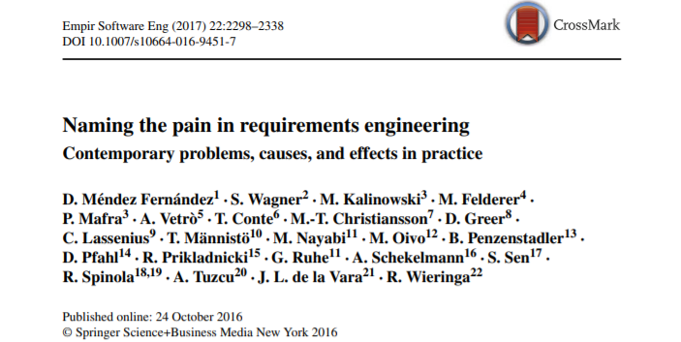

Examples of Surveys
Fernández, D. M.; Wagner, S.; Kalinowski, M.; Felderer, M.; Mafra, P.; Vetro, A.; Conte, T.; Christiansson, M.; Greer, D.; Lassenius, C.; Männistö, T.; Nayabi, M.; Oivo, M.; Penzenstadler, B.; Pfahl, D.; Prikladnicki, R.; Ruhe, G.; Schekelmann, A.; Sen, S.; Spínola, R. O.; Tuzcu, A.; de la Vara, J. L.; and Wieringa, R. Naming the pain in requirements engineering - Contemporary problems, causes, and effects in practice. Empirical Software Engineering, 22(5): 2298-2338. 2017.

Slide 13

Examples of Surveys
Wagner, S., Fernández, D. M., Felderer, M., Vetro, A., Kalinowski, M., Wieringa, R., Pfahl, D., Conte, T., Christiansson, M., Greer, D., Lassenius, C., Männistö, T., Nayebi, M., Oivo, M., Penzenstadler, B., Prikladnicki, R., Ruhe, G., Schekelmann, A., Sen, S., Spínola, R.O., Tuzcu, A., de la Vara, J. L., and Winkler, D, Status Quo in Requirements Engineering: A Theory and a Global Family of Surveys. ACM Transactions on Software Engineering and Methdology, 28(2): 9:1-9:48. 2019.

Slide 14
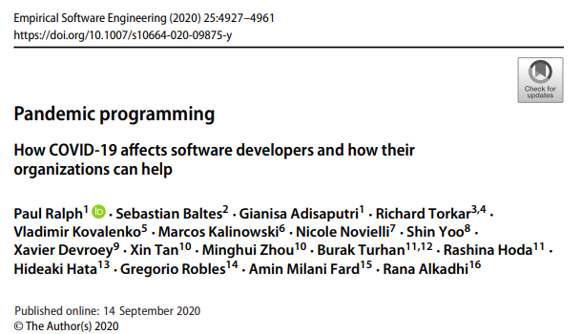
Examples of Surveys
Ralph, P., Baltes, S., Adisaputri, G., Torkar, R., Kovalenko, V., Kalinowski, M., Novielli, N., Yoo, S., Devroey, X., Tan, X., Zhou, M., Turhan, B., Hoda, R., Hata, H., Robles, G., Fard, A. M., and Alkadhi, R, Pandemic Programming How COVID-19 affects software developers and how their organizations can help. Empirical Software Engineering (2020), 25: 4927-4961. 2020.

Slide 15
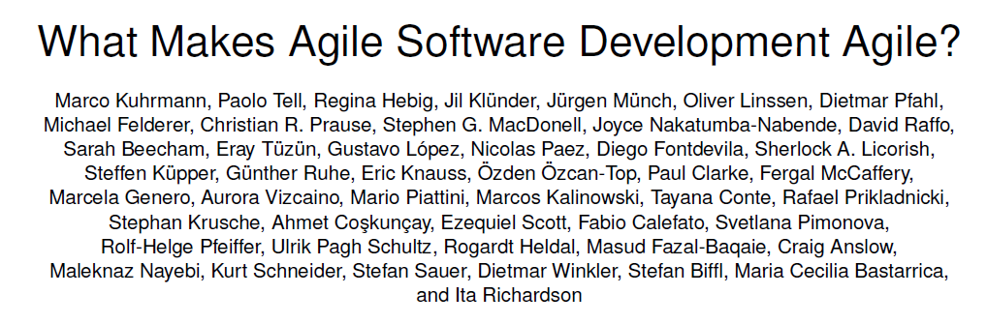
Examples of Surveys
Kuhrmann, M., Tell, P., Hebig, R. et al. What Makes Agile Software Development Agile? Submitted to Transactions on Software Engineering (2021).

Slide 16

Key Takeaways on Characteristics and Purpose of Survey Research
Characteristics of survey research methods, including strengths and limitations.
General objectives that surveys can fulfill.

Slide 17
3) Designing and Evaluating Survey Instruments (LO2)
For further information, see section 3.2 in the chapter.

Slide 18

Survey Design
Basics of Survey Design
Goal-Question-Metric-Driven Design
Theory-Driven Design
Issues When Assessing Psychological Constructs
Survey Instrument Evaluation

Slide 19
Basics of Survey Design
QUESTIONNAIRE
TYPES
QUESTION
TYPES
QUESTION
CATEGORIES
Self-administered questionnaire
Interviewer-administered questionnaire
Open-ended
Closed-ended
Hybrid questions
Demographic questions
Substantive questions
Filter questions
Sensitive questions

Slide 20



Basics of Survey Design
Measurement scales
Nominal
Values can be counted
Conditions that must be fulfilled to get appropriate responses
Ordinal
Questions must be understandable by the target population
Values can be counted and ordered
More Information
Respondents must have sufficient knowledge to answer
Interval
Values can be counted and ordered
Distance between values can be interpreted
Participants must be motivated and willing to participate
Ratio
Values can be counted and ordered
Distance between values can be interpreted
Radio between values can be interpreted

Slide 21
Basics of Survey Design
Suggestions to avoid common question wording problems
(adapted from Kitchenham and Pfleeger, 2008)
Using appropriate and simple language
Avoiding technical terms
Keeping questions short
Avoiding vague sentences
Avoiding sensitive questions
Avoiding too demanding questions
Avoiding double-barreled questions
Avoiding double negatives
Avoid asking about long gone events
In a survey, we can either ask for the opinions of the participants on topics or for specific facts that they experienced.

Slide 22
Basics of Survey Design
A very simplified process for survey research:
Survey Planning
Survey Execution
Packaging & Reporting
Characterising Target Population
Data Coding & Editing
Data Curation & Disclosure
Sampling
Post-survey Adjustments
Questionnaire Design
Data Analysis & Interpretation
Recruiting & Measuring

Slide 23

Survey Instrument Evaluation Methods
There are too many pitfalls to be handled. For further information, see the work of Torchiano et al. about lessons learnt in conducting survey research.
Torchiano, M., Méndez Fernández, D., Travassos, G.H., de Mello, R. M. (2017). Lessons Learnt in Conducting Survey Research. In: Proc. 5th International Workshop on Conducting Empirical Studies in Industry (CESI). ICSE 2017.

Slide 24
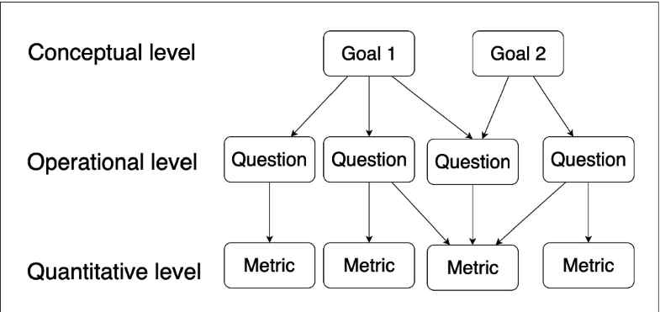
Goal-Question-Metric-Driven Design
Based on the Goal Question Metric (GQM) Paradigm (Basili and Romback, 1988)
GQM defines a way to plan and execute measurement and analysis activities:
1
Starts with the declaration of the measurement, Goals
2
From the goals, Questions that we would like to answer with the data interpretation are defined
Finally, from the questions, the Metrics and the data to be collected are defined
3
Basili, V.R. and Rombach, H.D., 1988. The TAME project: Towards improvement-oriented software environments. IEEE Transactions on software engineering, 14(6), pp.758-773.

Slide 25
Goal Definition Template
Analyze <object of study>
with the purpose of <goal>
with respect to <quality focus>
from the point of view of the <perspective> in the context of <context>
Measurement activities need clear goals
GQM: characterize, understand, evaluate, predict, improve.
Basili, V.R. and Rombach, H.D., 1988. The TAME project: Towards improvement-oriented software environments. IEEE Transactions on software engineering, 14(6), pp.758-773.

Slide 26
Goal Definition Template (Example)
Analyze the profile of software development organizations
with the purpose of characterizing
with respect to the organizations’ current profile, satisfaction degree regarding the MPS model, variation of presence in international markets, variation of exportation volume, and variation concerning cost, estimation accuracy, productivity, quality, user satisfaction, and return of investment (ROI)
from the point of view the software development organizations
in the context of software development organizations with unexpired MPS-SW assessments published in the SOFTEX portal.
Kalinowski, M., Weber, K.C. and Travassos, G.H., 2008, October. iMPS: an experimentation based investigation of a nationwide software development reference model. In Proceedings of the Second ACM-IEEE international symposium on Empirical Software Engineering and Measurement (ESEM).

Slide 27
Further Goal-Question-Metric-Driven Design Examples
“Analyze Social BPM with the purpose of characterizing with respect to adoption of its practices and technologies during the BPM lifecycle from the point of view of BPM participants or managers In the context of Brazilian organizations.”
Batista, M., Magdaleno, A. and Kalinowski, M., 2017, May. A Survey on the use of Social BPM in Practice in Brazilian Organizations. In Anais do XIII Simpósio Brasileiro de Sistemas de Informação (SBSI) (pp. 436-443). SBC.
“Analyze V&V methods with the purpose of characterization with respect to their suitability for addressing ISO 25010 software quality characteristics from the point of view of experts in the area of V&V in the context of the software engineering research community.”
Mendoza, I., Kalinowski, M., Souza, U. and Felderer, M., 2019, January. Relating verification and validation methods to software product quality characteristics: results of an expert survey. In Proc. of the Software Quality Days Conference (SWQD) (pp. 33-44).

Slide 28
Goal Definition Template (Example)
GOAL
Analyze software development organizations
with the purpose of characterizing
with respect to the organizations’ current profile, satisfaction degree regarding the MPS model, variation of presence in international markets, variation of exportation volume, and variation concerning cost, estimation accuracy, productivity, quality, user satisfaction, and return of investment (ROI)
from the point of view the software development organizations
in the context of software development organizations with unexpired MPS-SW assessments published in the SOFTEX portal
Kalinowski, M., Weber, K.C. and Travassos, G.H., 2008, October. iMPS: an experimentation based investigation of a nationwide software development reference model. In Proceedings of the Second ACM-IEEE international symposium on Empirical Software Engineering and Measurement (ESEM).

Slide 29
Goal Definition Template (Example)
QUESTION
Q1: What is the organization’s estimation accuracy?
METRICS
M1.1: Average Project Duration = Average duration of projects conducted within the last 12 months, measured in months.
M1.2: Average Project Estimated Duration = Average estimated duration of projects conducted within the last 12 months, measured in months.
M1.3: Estimation Accuracy = 1 - |((Average Project Duration – Average Project Estimated Duration) / Average Project Duration)|
Kalinowski, M., Weber, K.C. and Travassos, G.H., 2008, October. iMPS: an experimentation based investigation of a nationwide software development reference model. In Proceedings of the Second ACM-IEEE international symposium on Empirical Software Engineering and Measurement (ESEM).

Slide 30
Goal Definition Template (Example)
QUESTION
Q2: What is the organization’s Return of Investment (ROI) of adopting MPS-SW?
METRICS
M2.1: Variation in net sales = Percentage of variation in net sales.
M2.2: Investment in implementing MPS = Percentage of net sales invested in implementing MPS
M2.3: Investment in assessing MPS = Percentage of net sales invested in the MPS assessment
M2.4: ROI = (Variation in net sales / (Investment in implementing MPS + Investment in assessing MPS)) * 100
Kalinowski, M., Weber, K.C. and Travassos, G.H., 2008, October. iMPS: an experimentation based investigation of a nationwide software development reference model. In Proceedings of the Second ACM-IEEE international symposium on Empirical Software Engineering and Measurement (ESEM).

Slide 31
Theory-Driven Survey Design
A theory provides explanations and understanding in terms of basic constructs and underlying mechanisms, which constitute an important counterpart to knowledge of passing trends and their manifestation (Hannay et al. 2007):
From the practical perspective, theories should be useful and explain or predict phenomena that occur in software engineering
From a scientific perspective, theories should guide and support further research in software engineering
THEORY BUILDING BLOCKS
(Sjøberg et al., 2008)
Constructs
Propositions
Explanations
Scope
Basili, V.R. and Rombach, H.D., 1988. The TAME project: Towards improvement-oriented software environments. IEEE Transactions on software engineering, 14(6), pp.758-773.

Slide 32
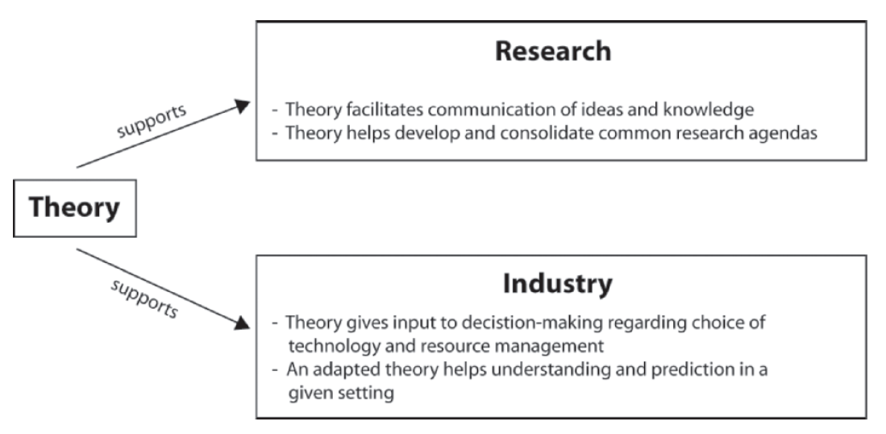
Theory-Driven Survey Design
Sjøberg, D.I., Dybå, T., Anda, B.C. and Hannay, J.E., 2008. Building theories in software engineering. In Guide to advanced empirical software engineering (pp. 312-336). Springer, London.

Slide 33
Theory-Driven Survey Design
Theory building and survey research are strongly interrelated;
Initial theories can be drawn from observations and available literature;
An initial theory may be a taxonomy of constructs or a set of statements relating constructs:
For NaPiRE, a set of constructs and propositions was elaborated based on available literature and expert knowledge,
For Pandemic Programming, a theoretical model was designed based on related work
The surveys, in both cases, were designed to test the theory (and to potentially extend it)

Slide 34
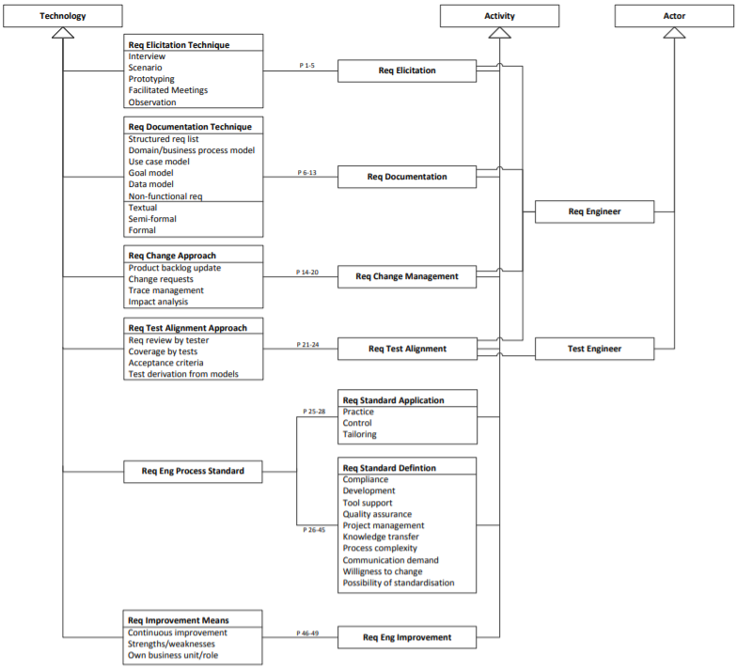
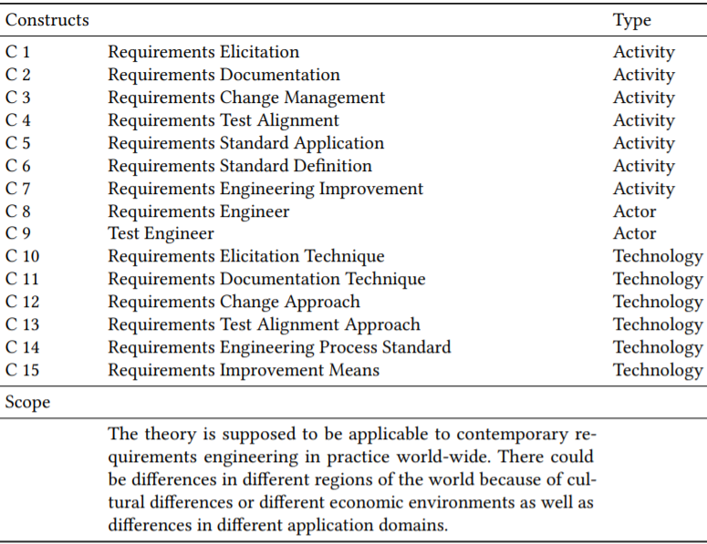
Theory-Driven Survey Design: NaPIRE
INITIAL THEORY
Wagner, S. et al. Status Quo in Requirements Engineering: A Theory and a Global Family of Surveys. ACM Transactions on Software Engineering and Methodology, 28(2): 9:1-9:48. 2019.

Slide 35
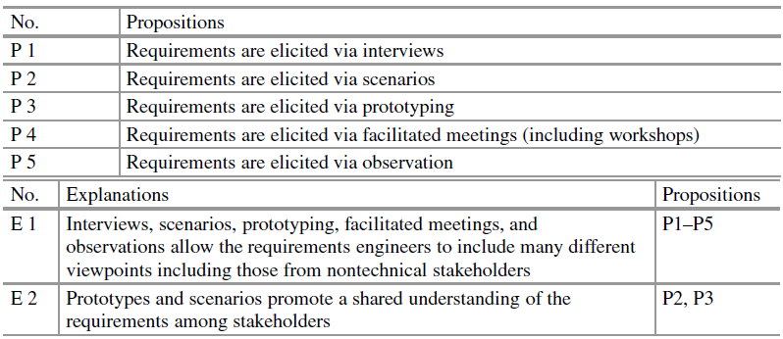
Theory-Driven Survey Design: NaPIRE
Wagner, S. et al. Status Quo in Requirements Engineering: A Theory and a Global Family of Surveys. ACM Transactions on Software Engineering and Methodology, 28(2): 9:1-9:48. 2019.

Slide 36
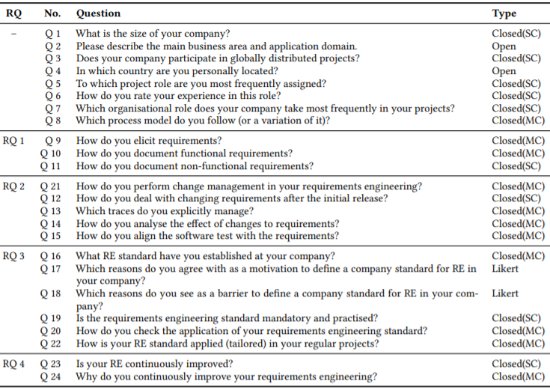
Theory-Driven Survey Design: NaPIRE
DESIGNED QUESTIONNAIRE
RQ 1 How are requirements elicited and documented?
RQ 2 How are requirements changed and aligned with tests?
RQ 3 How are RE standards applied and tailored?
RQ 4 How is RE improved?
Wagner, S. et al. Status Quo in Requirements Engineering: A Theory and a Global Family of Surveys. ACM Transactions on Software Engineering and Methodology, 28(2): 9:1-9:48. 2019.

Slide 37
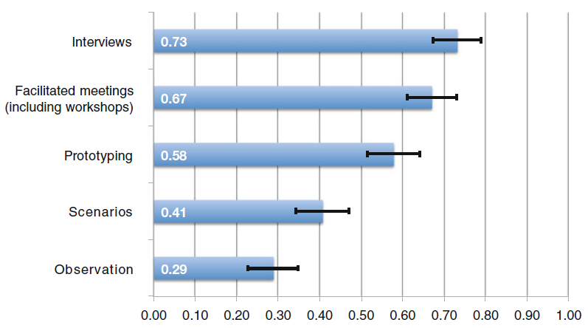
Theory-Driven Survey Design: NaPIRE
Wagner, S. et al. Status Quo in Requirements Engineering: A Theory and a Global Family of Surveys. ACM Transactions on Software Engineering and Methodology, 28(2): 9:1-9:48. 2019.

Slide 38
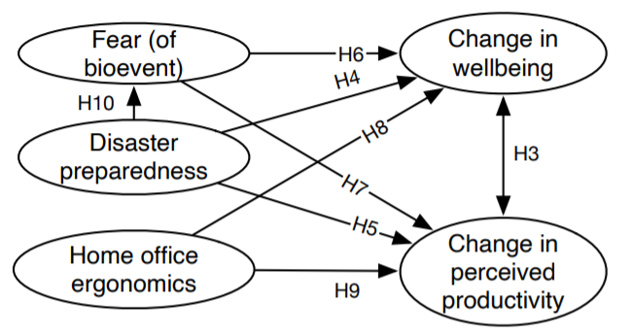
Theory-Driven Survey Design: Pandemic Programming
INITIAL THEORY
Ralph, P., Baltes, S., Adisaputri, G., Torkar, R., Kovalenko, V., Kalinowski, M., Novielli, N., Yoo, S., Devroey, X., Tan, X., Zhou, M., Turhan, B., Hoda, R., Hata, H., Robles, G., Fard, A. M., and Alkadhi, R, Pandemic Programming How COVID-19 affects software developers and how their organizations can help. Empirical Software Engineering (2020), 25: 4927-4961. 2020.

Slide 39
Theory-Driven Survey Design: Pandemic Programming
SELECTING VALIDATED SCALES FOR THE CONSTRUCTS
Change in wellbeing
We used the WHO’s five-item wellbeing index (WHO-5)
We adapted the Bracha-Burkle Fear and Resilience (FR) checklist, a triage tool for assessing patients’ reactions to bioevents (including pandemics).
Fear (of bioevent)
Change in perceived productivity
We used items from the WHO’s Health and Work Performance Questionnaire (HPQ)
We could not find a reasonable scale. Based on our reading of the ergonomics literature, we made a simple six-item, six-point Likert scale concerning distractions, noise, lighting, temperature, chair comfort and overall ergonomics.
Home office ergonomics
Disaster preparedness
We adapted Yong et al.’s (2017) individual disaster preparedness scale
Ralph, P., Baltes, S., Adisaputri, G., Torkar, R., Kovalenko, V., Kalinowski, M., Novielli, N., Yoo, S., Devroey, X., Tan, X., Zhou, M., Turhan, B., Hoda, R., Hata, H., Robles, G., Fard, A. M., and Alkadhi, R, Pandemic Programming How COVID-19 affects software developers and how their organizations can help. Empirical Software Engineering (2020), 25: 4927-4961. 2020.

Slide 40
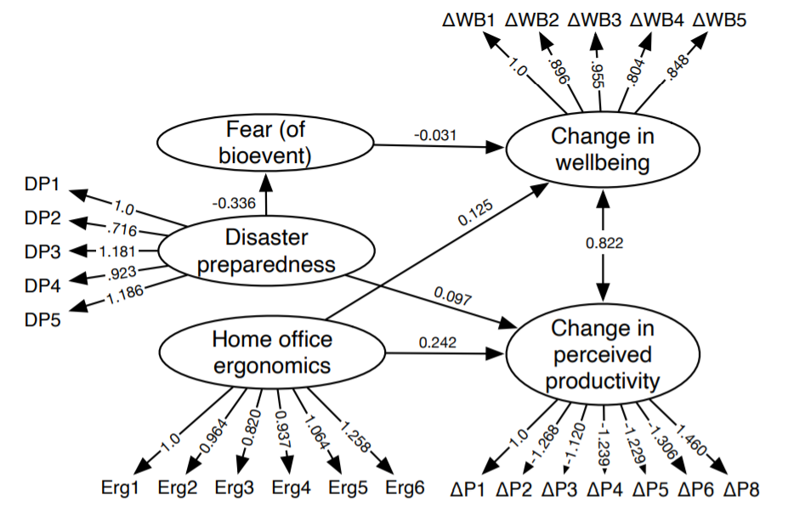
Theory-Driven Survey Design: Pandemic Programming
SUPPORTED MODEL
Ralph, P., Baltes, S., Adisaputri, G., Torkar, R., Kovalenko, V., Kalinowski, M., Novielli, N., Yoo, S., Devroey, X., Tan, X., Zhou, M., Turhan, B., Hoda, R., Hata, H., Robles, G., Fard, A. M., and Alkadhi, R, Pandemic Programming How COVID-19 affects software developers and how their organizations can help. Empirical Software Engineering (2020), 25: 4927-4961. 2020.

Slide 41
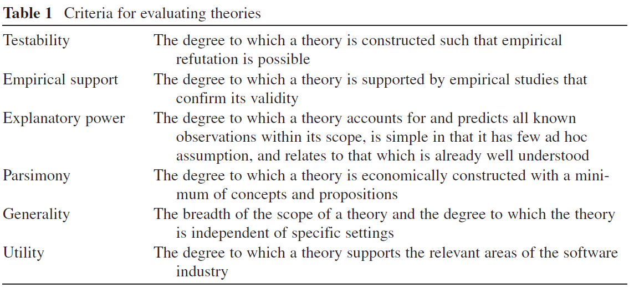
Evaluating Theories
Sjøberg, D.I., Dybå, T., Anda, B.C. and Hannay, J.E., 2008. Building theories in software engineering. In Guide to advanced empirical software engineering (pp. 312-336). Springer, London.

Slide 42
Survey Research and Theory Building
Key Takeaways (Wagner et al., 2020):
1
3
Survey research and theory building are strongly interrelated. The exact relationship depends on whether the theory is descriptive, explanatory, or predictive.
Survey data supports the definition or refinement of constructs, relationships, explanations, and the scope of a theory as well as testing of a theory.
2
4
Theories are of high value to guide the design of surveys.
Use validated scales as much as possible to improve construct validity.
Wagner, S., Mendez, D., Felderer, M., Graziotin, D. and Kalinowski, M., 2020. Challenges in survey research. In: Contemporary Empirical Methods in Software Engineering (pp. 93-125). Springer, Cham.

Slide 43
Issues When Assessing Psychological Constructs
Psychological constructs are theoretical concepts to model and understand human behavior, cognition, affect, and knowledge (Binning, 2016)
Examples include happiness, job satisfaction, motivation, commitment, personality, intelligence, skills, and performance
These constructs can only be assessed indirectly
We need ways to proxy our measurement of a construct in robust, valid, and reliable ways
🡪 This is why, whenever we wish to investigate psychological constructs and their variables, we need to either develop or adopt measurement instruments that are psychometrically validated
Scientists have investigated issues of validity and reliability of psychological tests
Binning JF (2016) Construct. https://www.britannica.com/science/construct

Slide 44


Issues When Assessing Psychological Constructs
Validity and Reliability in Psychometrics (AERA et al., 2014)
VALIDITY
RELIABILITY
The degree to which evidence and theory support the interpretation of test scores for proposed uses of tests
We need to ensure that any meaning we provide to the values obtained by a measurement instrument needs to be validated
Consistency of a questionnaire score in repeated instances of it; or
Coefficient between scores on two equivalent forms of the same test
AERA, APA, NCME: Standards for educational and psychological testing. American Educational Research Association, Washington, DC (2014)

Slide 45
Issues When Assessing Psychological Constructs
Software engineering research should favor psychometric validation of tests.
(Wagner et al., 2020)
Wagner, S., Mendez, D., Felderer, M., Graziotin, D. and Kalinowski, M., 2020. Challenges in survey research. In: Contemporary Empirical Methods in Software Engineering (pp. 93-125). Springer, Cham.

Slide 46
Issues When Assessing Psychological Constructs
Key Takeaways (Wagner et al., 2020):
1
3
Representing and assessing constructs on human behavior, cognition, affect, and knowledge is a difficult problem that requires psychometrically validated measurement instruments.
Adoption or development of psychometrically validated questionnaires should consider psychometric validity and reliability issues, which are diverse and very different from the usual and common validity issues we see in “Threats to Validity” sections.
2
4
Software engineering research should either adopt or develop psychometrically validated questionnaires.
Software engineering research should introduce studies on the development and validation of questionnaires.
Wagner, S., Mendez, D., Felderer, M., Graziotin, D. and Kalinowski, M., 2020. Challenges in survey research. In: Contemporary Empirical Methods in Software Engineering (pp. 93-125). Springer, Cham.

Slide 47
Survey Instrument Evaluation Methods
Used to assess the validity and reliability of the survey instrument;
A survey can be evaluated, to avoid threats to validity and reliability, using the following methods (Robson, 2002 apud Linaker et al., 2015):
EXPERT
REVIEWS
FOCUS
GROUPS
PILOT
SURVEYS
COGNITIVE
INTERVIEWS
EXPERIMENTS
Robson, C., (2002) Real World Research - A Resource for Social Scientists and Practitioner-Researchers, 2nd ed. Malden: Blackwell Publishing.

Slide 48
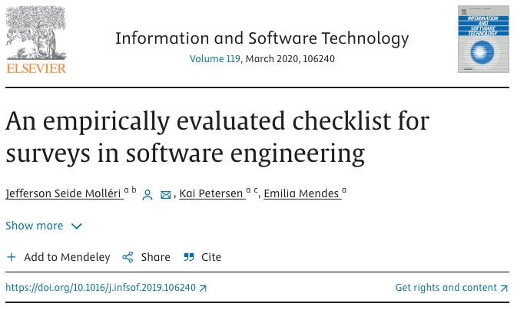
Survey Instrument Evaluation Methods
Additionally, the empirically evaluated checklist for surveys in software engineering by Molléri et al. [30] can be used as an additional valuable resource for evaluating the survey design (as well as the final survey report).
Molléri, J.S., Petersen, K., Mendes, E.: An empirically evaluated checklist for surveys in software engineering. Information and Software Technology 119, 106240 (2020)

Slide 49
Data Collection
Besides all methodological issues… Every survey needs a proper project plan:
Plan for methodological challenges
Find a proper project organisation early
Set up a proper project infrastructure
Develop a good project dissemination plan
Organise an efficient data collection
Organise an efficient data curation and analysis
Develop a good packaging and reporting pla

Slide 50
Key Takeaways on Teaching Designing and Evaluating Survey Instruments
Different types of questionnaires, question types, and question categories, as well as measurement scales and conditions for obtaining accurate responses.
The role of GQM-Driven and Theory-Driven survey design.
Survey instruments may be evaluated using different methods to avoid threats to validity and improve reliability.
Importance of using validated scales to improve construct validity.

Slide 51
4) Sampling and Data Collection (LO3)
For further information, see section 3.3 in the chapter.

Slide 52


Sampling
At the beginning of any design of survey research, we should clarify what the target population is that we try to characterize and generalize to
Statistical analysis relies on systematic sampling from this target population
In software engineering surveys, the unit of analysis that defines the granularity of the target population is often (de Mello et al. 2015):
AN ORGANIZATION
A SOFTWARE TEAM OR PROJECT
AN INDIVIDUAL
de Mello RM, da Silva PC, Travassos GH (2015) Investigating probabilistic sampling approaches for large-scale surveys in software engineering. Journal of Software Engineering Research and Development, 3(1):8.

Slide 53
Sampling
For common research questions, we are typically interested in producing results related to all organizations that develop software in the world or all software developers in the world.
We want to find theories that have a scope as wide as possible.
We have no solid understanding about the target population.
Which companies are developing software?
How many software developers are there in the world?
What are the demographics of software engineers in the world?
We face enormous difficulties to discuss representativeness of a sample, the needed size of the sample and, therefore, to what degree we can generalize our results.

Slide 54
Sampling
Scientists often rely on demographic information published by governmental or other public bodies such as statistical offices
These bodies are, so far, rather unhelpful for our task, because they do not provide a good idea about software-developing companies
There are possibilities to approach the demographics of software engineers
Commercial providers of data from large surveys such as Evans Data Corporation:
Estimated number of developers worldwide as of 2018: 23 million
Include information on different roles, genders, used development processes and technologies
An open alternative is the Stack Overflow Annual Developer Survey

Slide 55

Sampling
Having demographic information, we can design our survey in a way that we collect comparable data.
Then, we can compare the distributions in our survey and the larger surveys to estimate representativeness:
A
Should be part of the interpretation and discussion of the results;
B
Prevents us from overclaiming;
Gives us more credibility in case we cover the population well.
C

Slide 56
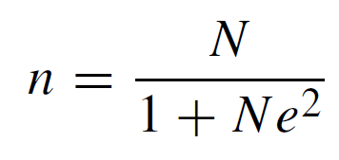
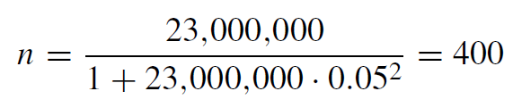
Sampling
A good sample size (n) can be estimated as follows (Yamane, 1973 apud Wagner et al., 2020):
n - sample size
N - population size
e - level of precision (often set to 0.05 or 0.01)
Reasonable sample size for software developers (using precision 0.05):

Slide 57
Sampling
1
3
There is no suitable official data on the number and properties of software developing companies in the world.
For individual software engineers, existing demographic studies can be used to assess a survey’s representativeness.
2
4
Ethics needs to be considered before contacting potential survey participants.
For the estimate of 23 million developers worldwide, a good sample size would be 400 respondents.

Slide 58
Sampling
Survey sampling strategies are crucial to understand because they directly impact the validity and generalizability of survey research results
Linaker et al. [26] present some common sampling strategies, dividing them into:
Non-probabilistic
Probabilistic
Convenience (Accidental) Sampling
Simple Random Sampling
Quota Sampling
Clustered Sampling
Purposive (Judgement) Sampling
Stratified Sampling
Snowball Sampling
Systematic Sampling

Slide 59
Data Collection
Strategies to approach the population
CLOSED INVITATIONS
Approaching known groups or individuals to participate per invitation-only;
Restricting the survey access to those invited.
OPEN INVITATIONS
Approaching a broader, often anonymous audience via open survey access;
Anyone with a link to the survey can participate.

Slide 60
Data Collection
Key Takeaways (Wagner et al., 2020):
1
2
Both strategies to approach the target population (closed and open invitations) can be applied, but have distinct implications on the survey design and the recruitment approaches.
Closed invitations are suitable in situations in which it is possible to precisely identify and approach a well-defined sample of the target population. They may also be required in situations where filtering out participants that are not part of the target population would be difficult, harming the sample representativeness.
3
Open invitations allow reaching out for larger samples. However, they typically require more carefully considering context factors when designing the survey instruments. These context factors can then be used during the analyses to filter out participants that are not representative (e.g., applying the blocking principle to specific context factors).
Wagner, S., Mendez, D., Felderer, M., Graziotin, D. and Kalinowski, M., 2020. Challenges in survey research. In: Contemporary Empirical Methods in Software Engineering (pp. 93-125). Springer, Cham.

Slide 61
Key Takeaways on Teaching Sampling and Data Collection
What are the fundamentals and strategies for sampling and data collection?
What strategies could be explored to approach the target population?

Slide 62
5) Statistical and Qualitative
Analysis (LO4)
For further information, see section 3.4 in the chapter.

Slide 63
Statistical Analysis
DESCRIPTIVE AND INFERENTIAL STATISTICS
With the often large number of participants in surveys, we usually aim at a statistical analysis of the survey results.
A majority of the questionnaires are typically composed of closed questions that have quantitative results.
NULL-HYPOTHESIS SIGNIFICANCE TESTING
BOOTSTRAPPING CONFIDENCE INTERVALS
BAYESIAN ANALYSIS
STRUCTURAL EQUATION MODELING

Slide 64
Statistical Analysis
Descriptive Statistics
The goal of descriptive statistics is to characterize the answers to one or more questions of our specific sample
We do not yet talk about generalizing to the population
Which descriptive statistic is suitable depends on what we are interested in most and the scale of the data
Scale | Nominal | Ordinal | Interval | Ratio
Values Counting | X | X | X | X
Values Ordering |  | X | X | X
Equidistant Intervals |  |  | X | X
Values Division |  |  |  | X

Slide 65
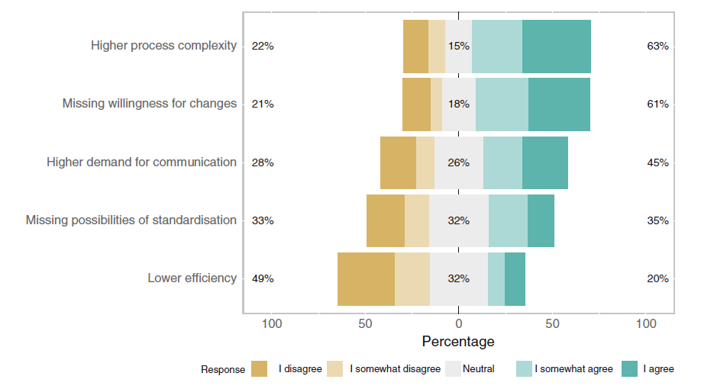
Statistical Analysis
Descriptive Statistics
Descriptive statistics for ordinal scales (e.g., Likert scales)
Frequency counting, mode, median, minimum, maximum, median absolute deviation (MAD), interquartile range (IQR)
An interesting alternative is showing the whole distribution of ordinal data in a stacked bar chart.
Generated using the Likert package in R
http://www.labape.com.br/rprimi/statR/T7_plus_likert.html
Wagner et al., 2019

Slide 66
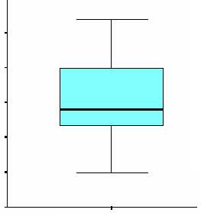
Statistical Analysis
Descriptive Statistics
For interval or ratio scales we can use all available descriptive statistics, such as mean, variance, and standard deviation.
Still, we recommend using boxplots, to enable eliminating outliers by using the quartile method
.
.
.
Outliers
Maximum Value
Quartile Method
Lower Outliers: Q1 - 1.5*IQR
Upper Outliers: Q3 + 1.5*IQR
Where IQR = Q3 – Q1.
3rd Quartile
Median
1st Quartile
Minimum Value

Slide 67
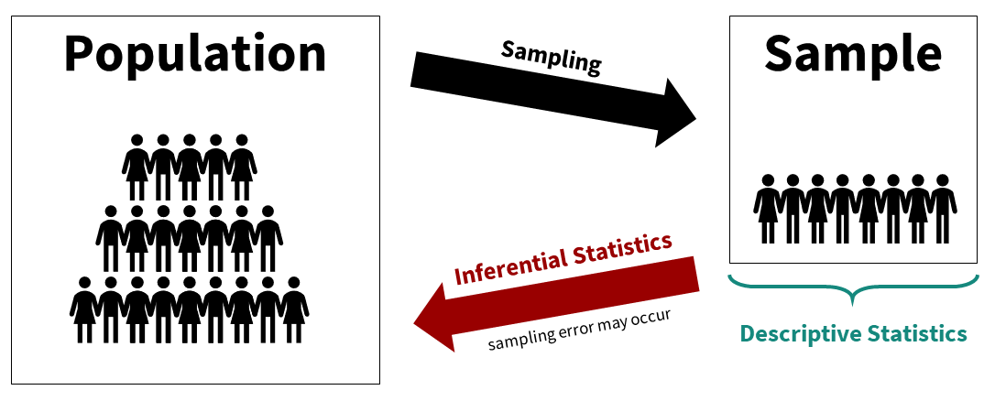
Statistical Analysis
Inferential Statistics
Descriptive statistics concern the sample
Inference statistics concern the population
Different possibilities for analyzing quantitative survey results, including:
null hypothesis significance testing;
bootstrapping with confidence intervals;
bayesian analysis;
structural equation modeling.
Source: https://danawanzer.github.io/stats-with-jamovi/descriptive-vs-inferential-statistics.html

Slide 68
Statistical Analysis
Null-hypothesis Significance Testing (NHST)
We need hypotheses to evaluate
A survey should be guided by a theory
Propositions can be operationalized into hypotheses to test with the survey data
In surveys we typically have:
Point estimate hypotheses for answers to single questions
Hypotheses on correlations between answers to two questions

Slide 69
Statistical Analysis
Null-hypothesis Significance Testing (NHST)
In general, two hypotheses are defined
Null Hypothesis
(H0)
Alternative Hypothesis (H1)
Indicates the observed differences are coincidental. It means that this is the hypothesis the researcher would like most to reject with high confidence
Represents the hypothesis indicating some type of effect, that can be accepted, or tested

Slide 70
Statistical Analysis
Null-hypothesis Significance Testing (NHST)
Types of Errors
Type I (α)
Type II (β)
It happens when the statistical test indicates the existence of a relationship between cause and effect that actually does not exist
It happens when the statistical test does not indicate a relationship between cause and effect that actually does exist
Statistics tests allow confirming or refuting hypotheses
(according to a previously defined significance level - α-value)

Slide 71
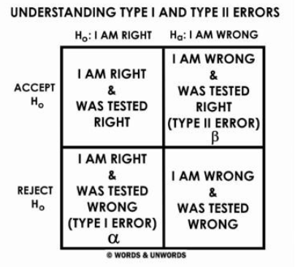
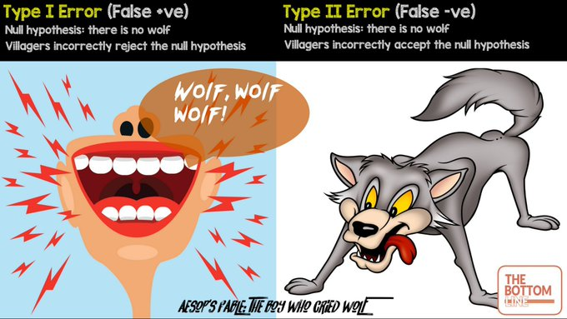
Statistical Analysis
Null-hypothesis Significance Testing (NHST)
Types of Errors
Source: https://www.graduatetutor.com/statistics-tutor/type-1-type-2-errors-hypothesis-testing-statistics/

Slide 72
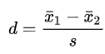
Statistical Analysis
Null-hypothesis Significance Testing (NHST)
Significance Testing
Shows the likelihood of an type-I error to happen
Most common significance level (α): 10%, 5%, 1% and 0.1%
We call p-value the lowest level of significance that can be used to reject the null hypothesis
We say there is statistical significance when the calculated p-value is lower than the adopted significance level (α-value)
Besides significance testing, it is important to also look at effect sizes.
Cohen's d is defined as the difference between two means divided by a standard deviation for the data:

Slide 73
Statistical Analysis
Null-hypothesis Significance Testing (NHST)
Several statistical significance tests can be applied, with differences in their statistical power
(Power= P (H0 rejected | Ho is false))
The statistical test with the highest power shall be used to evaluate the hypotheses
2 groups
t-test
paired Student's t-test
Normal Distribution Data
3+ groups
ANOVA, Tukey
Hypothesis Testing
2 groups
Mann-Whitney (Wilcoxon rank-sum test)
Wilcoxon signed-rank test
Non Normal Distribution Data
3+ groups
Kruskal-Wallis

Slide 74
Statistical Analysis
Null-hypothesis Significance Testing (NHST)
Several statistical significance tests can be applied, with differences in their statistical power
(Power= P (H0 rejected | Ho is false))
The statistical test with the highest power shall be used to evaluate the hypotheses
Normal Distribution Data
Pearson
Linear Regression
Relationship
Exploration
Non Normal Distribution Data
Spearman
Non-Linear Regression

Slide 75

Statistical Analysis
Null-hypothesis Significance Testing (NHST)
Problems with NHST
Dichotomous nature of its results
Requires a representative sample of the population, otherwise it is unclear what NHST actually means
We need alternatives...

Slide 76
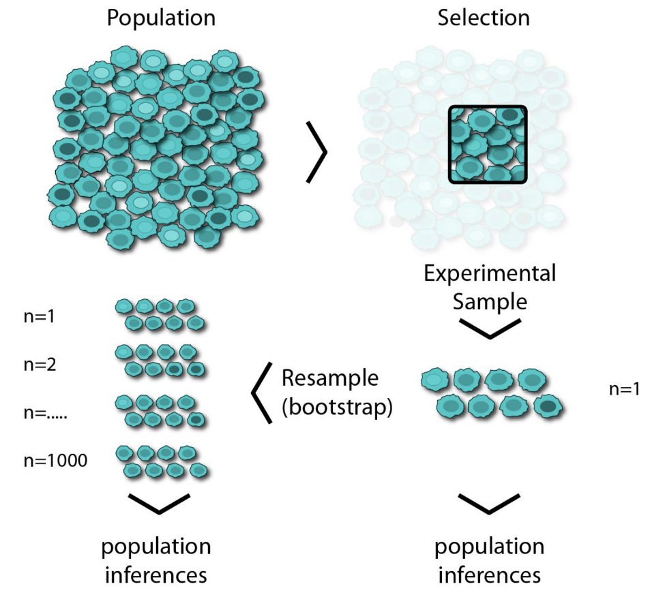
Statistical Analysis
Bootstrapping Confidence Intervals
Replaces fixed significance level thresholds
Involves estimating a confidence interval around a metric we are interested in
How large is the confidence interval?
How strongly do confidence intervals of methods to compare overlap?
Idea of bootstrapping:
We repeatedly take samples with replacement and calculate the statistic we are interested in
This is repeated a large number of times and, thereby, provides us with an understanding of the distribution of the sample
Source: https://medium.com/swlh/bootstrap-sampling-using-pythons-numpy-85822d868977

Slide 77
Bootstrapping Confidence Intervals: Example
1000 times resampling for bootstrapping confidence intervals
Source: https://medium.com/swlh/bootstrap-sampling-using-pythons-numpy-85822d868977
The Bootstrap Assumption: The original sample approximates the population from which it was drawn. So resamples from this sample approximate what we would get if we took many samples from the population. The bootstrap distribution of a statistic, based on many resamples, approximates the sampling distribution of the statistic, based on many samples.

Slide 78
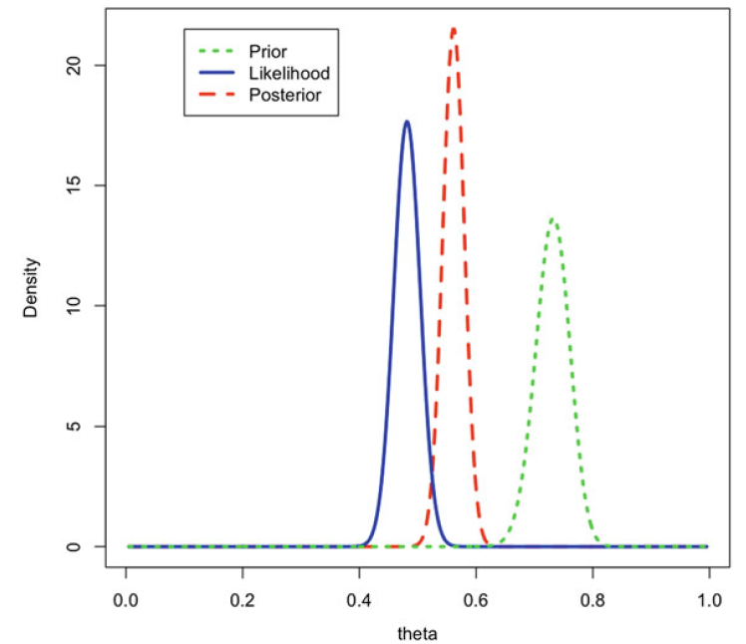
Statistical Analysis
Bayesian Analysis
In Bayesian statistics, probability is understood as a representation of the state of knowledge or belief
Acknowledges uncertainty
Allows integrating existing evidence and accumulating knowledge
Further reading:
NaPiRE
run 2
NaPiRE
run 3
Torkar, R., Feldt, R. and Furia, C.A., 2020. Bayesian Data Analysis in Empirical Software Engineering: The Case of Missing Data. In Contemporary Empirical Methods in Software Engineering (pp. 289-324). Springer, Cham.
Workshops for eliciting requirements (Wagner et al., 2020)

Slide 79
Statistical Analysis
Structural Equation Modeling
Used to test theories involving constructs (also called latent variables).
In our Pandemic Programming survey example fear, disaster preparedness, home office ergonomics, wellbeing and productivity are all constructs
To design a structural equation model, we first define a measurement model, which maps each reflective indicator into its corresponding construct.
For example, each of the five items comprising the WHO5 wellbeing scale is modeled as a reflective indicator of wellbeing
SEM uses Confirmatory Factor Analysis (CFA) to estimate each construct as the shared variance of its respective indicators

Slide 80
Statistical Analysis
Structural Equation Modeling
Next, we define the structural model, which identifies the expected relationships among the constructs
The constructs we are attempting to predict are referred to as endogenous (dependent variables), while the predictors are exogenous (independent variables)
SEM uses a path modeling technique (e.g. regression) to build a model that predicts the endogenous (latent) variables based on the exogenous variables, and to estimate both the strength of each relationship and the overall accuracy of the model.

Slide 81
Structural Equation Modeling Example: Pandemic Programming
Supported Model
The arrows between the constructs show the supported causal relationships.
The path coefficients (the numbers on the arrows) indicate the relative strength and direction of the relationships.
Ralph, P., Baltes, S., Adisaputri, G., Torkar, R., Kovalenko, V., Kalinowski, M., Novielli, N., Yoo, S., Devroey, X., Tan, X., Zhou, M., Turhan, B., Hoda, R., Hata, H., Robles, G., Fard, A. M., and Alkadhi, R, Pandemic Programming How COVID-19 affects software developers and how their organizations can help. Empirical Software Engineering (2020), 25: 4927-4961. 2020.

Slide 82
Statistical Analysis
Key Takeaways (Wagner et al., 2020):
1
2
3
Always make clear whether you aim at analyzing opinions or facts
Descriptive statistics are always helpful
NHST inferential statistics are useful to test theoretical propositions
4
5
6
Bootstrapping confidence intervals helps to deal with uncertain sampling
Bayesian analysis allows us to directly integrate prior knowledge
SEM is a powerful multivariate analysis technique that is widely used in the social sciences and that should be further used in computer science research
Wagner, S., Mendez, D., Felderer, M., Graziotin, D. and Kalinowski, M., 2020. Challenges in survey research. In: Contemporary Empirical Methods in Software Engineering (pp. 93-125). Springer, Cham.

Slide 83
Qualitative Analysis
Besides the common focus on statistical analysis, surveys can also be qualitative and contain open questions
Open questions do not impose restrictions on respondents and allow them to more precisely describe the phenomena of interest according to their perspective and perceptions
However, they can lead to a large amount of qualitative data to analyze, which is not easy and may require a significant amount of resources
We recommend referring to chapter “Qualitative Data Analysis in Software Engineering: Techniques and Teaching Insights” for further advice on teaching qualitative methods

Slide 84



Qualitative Analysis
The answers to such open questions can help researchers to further understand a phenomenon eventually including causal relations among theory constructs and theoretical explanations
Open questions can help generating new theories
There are at least three main streams of GT:
Glaser’s GT (classic or Glaserian GT) (Glaser, 1992)
Corbin and Strauss’ GT (Straussian GT) (Corbin and Strauss, 1990)
Charmaz’s constructivist GT (Charmaz, 2014)
A research method commonly employed to support qualitative analyses is Grounded Theory.
Grounded theory, “in theory”, involves inductively generating theory from data.
Few “GT” Studies Generate Theory (Stol et al., 2016).

Slide 85
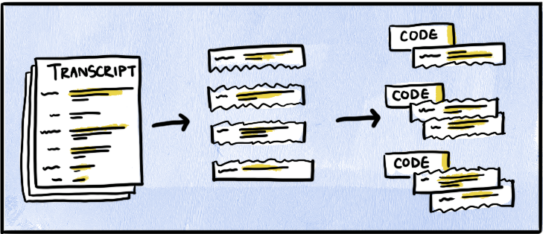
Qualitative Analysis
1
2
Turn your data into small, discrete components of data
Code each discrete pieces of data with a descriptive label
Source: https://delvetool.com/blog/openaxialselective
Corbin, J.M. and Strauss, A., 1990. Grounded theory research: Procedures, canons, and evaluative criteria. Qualitative sociology, 13(1), pp.3-21.

Slide 86
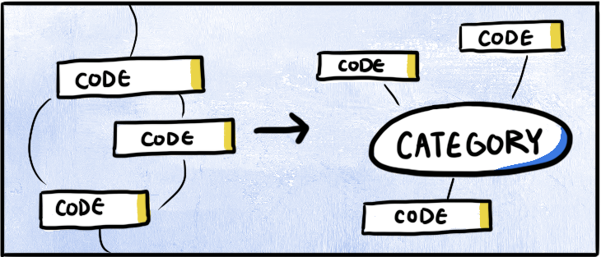
Qualitative Analysis
3
4
Find connections and relationships between codes
Aggregate and condense codes into broader categories
Source: https://delvetool.com/blog/openaxialselective
Corbin, J.M. and Strauss, A., 1990. Grounded theory research: Procedures, canons, and evaluative criteria. Qualitative sociology, 13(1), pp.3-21.

Slide 87
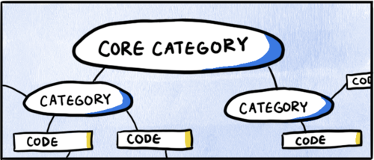
Qualitative Analysis
5
Bring it together with one overarching category
6
Identify the connections between this overarching category and the rest of your codes and data
7
Remove categories or codes that don’t have enough supporting data
Source: https://delvetool.com/blog/openaxialselective
8
Read the transcript again, and code according to this overarching category
Corbin, J.M. and Strauss, A., 1990. Grounded theory research: Procedures, canons, and evaluative criteria. Qualitative sociology, 13(1), pp.3-21.

Slide 88
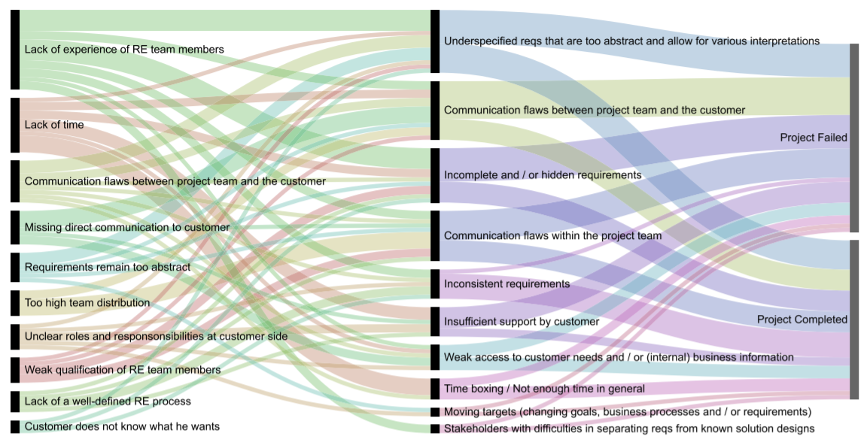
Qualitative Analysis: Example
Fernández, D. M.; Wagner, S.; Kalinowski, M.; Felderer, M.; Mafra, P.; Vetro, A.; Conte, T.; Christiansson, M.; Greer, D.; Lassenius, C.; Männistö, T.; Nayabi, M.; Oivo, M.; Penzenstadler, B.; Pfahl, D.; Prikladnicki, R.; Ruhe, G.; Schekelmann, A.; Sen, S.; Spínola, R. O.; Tuzcu, A.; de la Vara, J. L.; and Wieringa, R. Naming the pain in requirements engineering - Contemporary problems, causes, and effects in practice. Empirical Software Engineering, 22(5): 2298-2338. 2017.

Slide 89
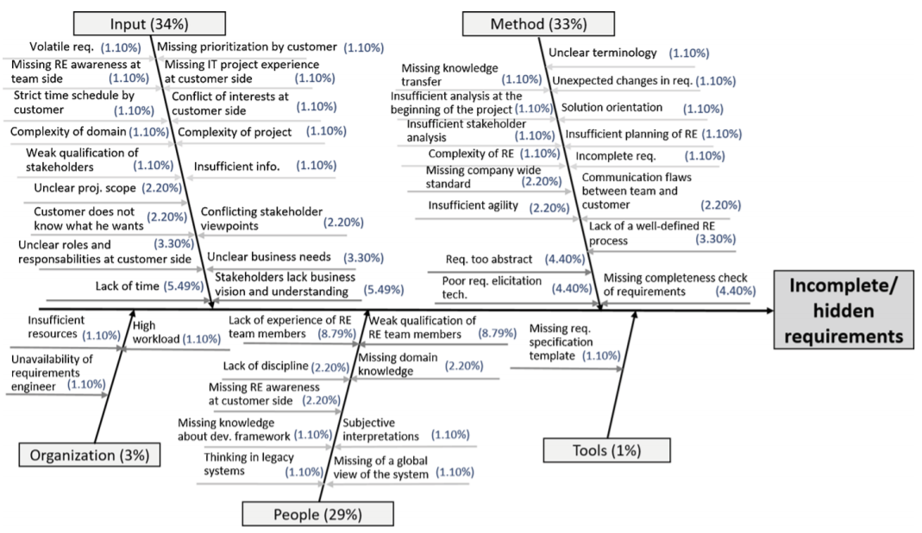
Qualitative Analysis: Example
Fernández, D. M.; Wagner, S.; Kalinowski, M.; Felderer, M.; Mafra, P.; Vetro, A.; Conte, T.; Christiansson, M.; Greer, D.; Lassenius, C.; Männistö, T.; Nayabi, M.; Oivo, M.; Penzenstadler, B.; Pfahl, D.; Prikladnicki, R.; Ruhe, G.; Schekelmann, A.; Sen, S.; Spínola, R. O.; Tuzcu, A.; de la Vara, J. L.; and Wieringa, R. Naming the pain in requirements engineering - Contemporary problems, causes, and effects in practice. Empirical Software Engineering, 22(5): 2298-2338. 2017.

Slide 90
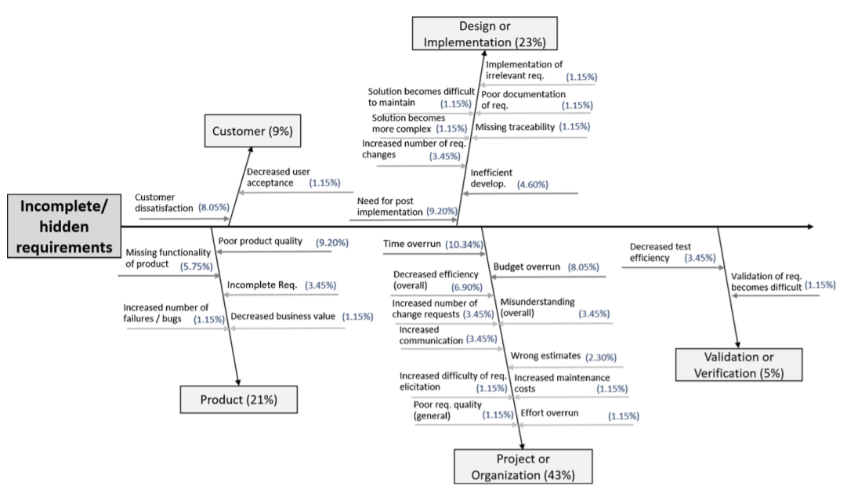
Qualitative Analysis: Example
Fernández, D. M.; Wagner, S.; Kalinowski, M.; Felderer, M.; Mafra, P.; Vetro, A.; Conte, T.; Christiansson, M.; Greer, D.; Lassenius, C.; Männistö, T.; Nayabi, M.; Oivo, M.; Penzenstadler, B.; Pfahl, D.; Prikladnicki, R.; Ruhe, G.; Schekelmann, A.; Sen, S.; Spínola, R. O.; Tuzcu, A.; de la Vara, J. L.; and Wieringa, R. Naming the pain in requirements engineering - Contemporary problems, causes, and effects in practice. Empirical Software Engineering, 22(5): 2298-2338. 2017.

Slide 91
Qualitative Analysis
Key Takeaways (Wagner et al., 2020):
1
3
When preparing your survey, invest effort in avoiding confounding factors that may interfere in having respondents focusing mainly on the survey question when providing their answers (e.g., language issues). Assess the instrument validity.
When reporting the qualitative analysis of your survey, explicitly state your research method, providing details on eventual deviations.
2
4
Applying coding and analysis techniques from Grounded Theory can help to understand qualitative data gathered through open questions.
To avoid researcher bias and improve the reliability of the results, qualitative analyses should be conducted in teams and make use of independent validations. Also, ideally the raw and analyzed data should be open to enable other researchers to replicate the analysis procedures.
Wagner, S., Mendez, D., Felderer, M., Graziotin, D. and Kalinowski, M., 2020. Challenges in survey research. In: Contemporary Empirical Methods in Software Engineering (pp. 93-125). Springer, Cham.

Slide 92
Key Takeaways on Teaching Statistical and Qualitative Analysis
Descriptive statistics provide a foundation for understanding data by summarizing key characteristics, while alternatives to traditional inferential statistics offer robust tools for analyzing data under various conditions and assumptions
Open questions enrich qualitative research by capturing detailed and nuanced responses.

Slide 93
6) Threats to Validity and Reliability (LO5)
For further information, see section 3.5 in the chapter.

Slide 94
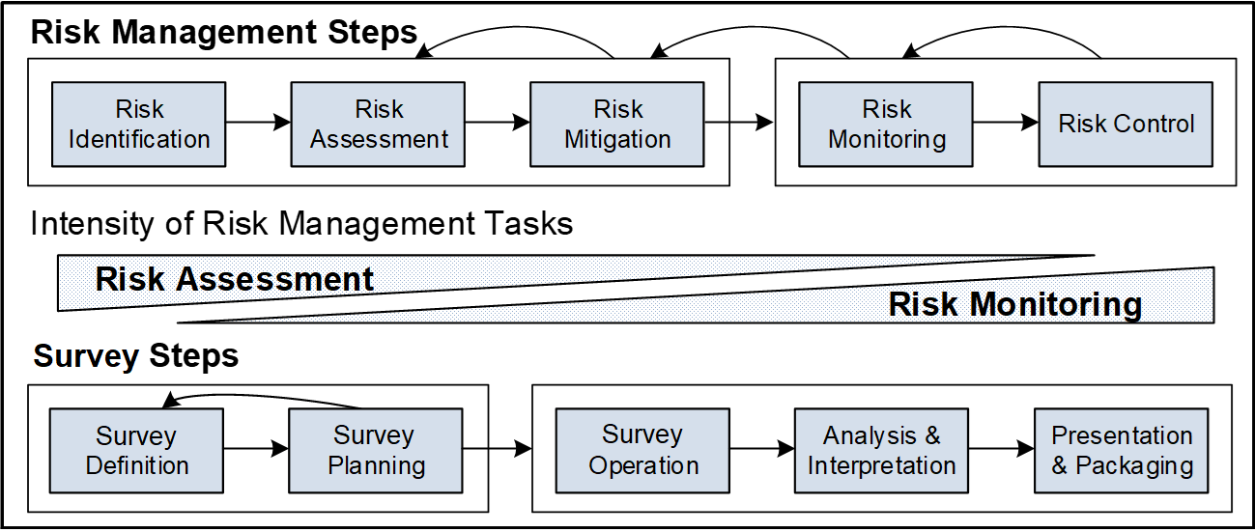
Survey Risk Management
Validity is a property of inferences and every study faces Threats to Validity (Biffl et al., 2014).
Biffl, S., Kalinowski, M., Ekaputra, F., Neto, A.A., Conte, T. and Winkler, D., 2014, September. Towards a semantic knowledge base on threats to validity and control actions in controlled experiments. In Proceedings of the 8th ACM/IEEE International Symposium on Empirical Software Engineering and Measurement (pp. 1-4).

Slide 95
Validity Assessment
In psychometrics, validity concerns “the degree to which evidence and theory support the interpretation of test scores for proposed uses of tests” (AERA et al., 2014)
FACE VALIDITY
CONTENT VALIDITY
(aka criterion validity in this context)
Rust (2009) summarized six facets of validity in the context of psychometric tests:
PREDICTIVE VALIDITY
CONCURRENT VALIDITY
CONSTRUCT VALIDITY
DIFFERENTIAL VALIDITY
AERA, APA, NCME (2014) Standards for educational and psychological testing. American Educational Research Association, Washington.
Rust J (2009) Modern psychometrics: the science of psychological assessment. Routledge, Hove, East Sussex New York.

Slide 96
Validity Assessment
In software engineering we typically aim at assessing whether it is possible to safely conclude that a survey measures what it is supposed to:
FACE VALIDITY
Typically involves a lightweight review of the questionnaire by randomly chosen respondents
The following validity types are discussed in this context (Kitchenham and Pfleeger, 2008 apud Linaker et al., 2015):
Refers to how the questionnaire can separate between respondents that belong to different groups. An existing classification and mapping of the different groups in the target population must be in place
CRITERION VALIDITY
Typically involves having a (focus) group of reviewers evaluating the questionnaire. The group should include subject matter experts and example respondents from the target population
CONTENT VALIDITY
Kitchenham, B.A. and Pfleeger, S.L., 2008. Personal opinion surveys. In Guide to advanced empirical software engineering (pp. 63-92). Springer, London.

Slide 97
Validity Assessment
In software engineering we typically aim at assessing whether it is possible to safely conclude that a survey measures what it is supposed to:
FACE VALIDITY
Typically involves a lightweight review of the questionnaire by randomly chosen respondents
Refers to how the questionnaire can separate between respondents that belong to different groups. An existing classification and mapping of the different groups in the target population must be in place
The following validity types are discussed in this context (Kitchenham and Pfleeger, 2008 apud Linaker et al., 2015):
CRITERION VALIDITY
Typically involves having a (focus) group of reviewers evaluating the questionnaire. The group should include subject matter experts and example respondents from the target population
CONTENT VALIDITY
CONSTRUCT VALIDITY
How well the question actually measures the construct it was intended to by the designer
Kitchenham, B.A. and Pfleeger, S.L., 2008. Personal opinion surveys. In Guide to advanced empirical software engineering (pp. 63-92). Springer, London.

Slide 98
Reliability Assessment
Reliability (aka External Validity and Generalizability):
TEST-RETEST RELIABILITY
PHRASING / REORDER EFFECT RELIABILITY
The same subject responds to the same survey two times, and it is measured whether the subject gives the same answers each time;
Kitchenham and Pfleeger (2008) state that if the correlation between both of the answers is greater than 0.7 the test-retest reliability can be considered good.
Testing whether the phrasing or reordering of questions has any effect on the answers by a respondent (assesses instrument bias on the respondent).

Slide 99
Reliability Assessment
Reliability (aka External Validity and Generalizability):
INTER-OBSERVER RELIABILITY
INTER-OBSERVER RELIABILITY
Assesses observer interview bias in not self-administered surveys;
Assesses observer analysis bias (e.g., when interpreting and decoding open ended questions);
Typically addressed by having two or more observers involved in the interview and analysis process
If conclusions are to be drawn on the whole population, not just on the sample, the reliability needs to be proven and established

Slide 100
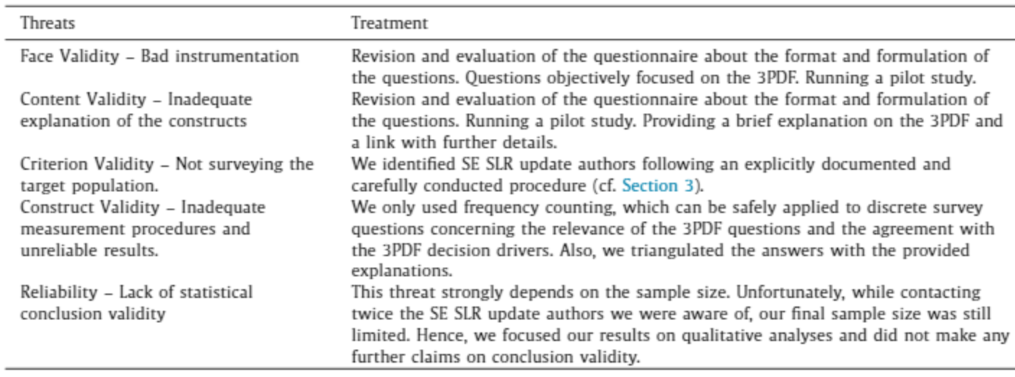
Threats to Validity and Reliability: Example
Reliability (aka External Validity and Generalizability):
Mendes, E., Wohlin, C., Felizardo, K. and Kalinowski, M., 2020. When to update systematic literature reviews in software engineering. Journal of Systems and Software, 167, p.110607.

Slide 101
Key Takeaways on Teaching Threats to Validity and Reliability
Understanding and ensuring validity and reliability are fundamental for conducting trustworthy and thorough software engineering surveys. Validity ensures that the survey measures what it is intended to measure, while reliability ensures consistent results across different instances of the survey.
Different types of validity are essential in survey research to ensure that the survey accurately reflects the concept being studied.

Slide 102
7) Ethical Considerations (LO5)
For further information, see section 3.6 in the chapter.

Slide 103
Ethical Considerations
Ethical considerations are paramount in survey research within software engineering, as they ensure respect for participants, the integrity of the data, and the credibility of the research findings.

Slide 104
Ethical Considerations
In software engineering, there is yet no established standard or guidelines on how to conduct surveys ethically
The Insight Association provides ethical guidelines that consider unethical sampling, among other practices: “Collection of respondent emails from Websites, portals, Usenet or other bulletin board postings without specifically notifying individuals that they are being ‘recruited’ for research purposes”.
We will probably need flexible rules and guidelines to keep developers in social media from being spammed by study requests while still allowing research to take place.
We should all consider thoughtfully how and whom we contact for a survey study.

Slide 105
Ethical Considerations
INFORMED CONSENT
PRIVACY AND CONFIDENTIALITY
INSTITUTIONAL ETHICS REVIEW
Participants must be fully informed about the nature of the research, what it involves, the risks and benefits, and their rights to withdraw at any time without penalty.
Researchers must protect the privacy of participants and the confidentiality of their data, using data encryption and anonymization techniques where appropriate.
Submitting survey research to institutional ethics review boards, as they will ensure the research adheres to ethical standards and protects participant

Slide 106
Key Takeaways on Teaching Ethical Considerations
Ethics needs to be considered before contacting potential survey participants. Participants must be fully informed about the nature of the research, what it involves, the risks and benefits, and their rights to withdraw at any time without penalty.
Pay attention to the role of the institutional ethics review boards and how to report survey ethics in software engineering publications.

Slide 107
8) Concluding Remarks
For further information, see section 3.6 in the chapter.

Slide 108
Concluding Remarks
We have explored effective strategies for survey research, combining theoretical foundations with practical applications.

Slide 109
Teaching Survey Research in Software Engineering
Handbook on Teaching Empirical Software Engineering
Authors:
Marcos Kalinowski (Pontifical Catholic University of Rio de Janeiro)
Allysson Allex Araújo (Federal University of Cariri)
Daniel Mendez (Blekinge Institute of Technology)

